Slide 1
Exercise and Fitness Metrics Analysis
By : Team 4 - Enigma

Slide 2



The Problem Identifying patterns in exercise data can help prevent injuries and improve training effectiveness | The Solution Using data science tools, we analyzed exercise and fitness metrics to uncover trends and insights. | The Result Our analysis provides valuable insights that can be used to optimize training techniques and techniques.

Slide 3

Dataset Overview
What's inside? | Structured
Explore a dataset with 3865 observations and 11 features | Our dataset is complete and carefully selected to ensure that you're working with the most relevant information.

Slide 4
Data Preprocessing
Conversion of Data Types from Character to Factor
Typecasted Exercise, Gender, and Weather Conditions columns
BMI categories – Healthy, Overweight and Obese. Intensity categorizes - High, medium and low intensity.
Creation of new categories for BMI and Intensity

Slide 5
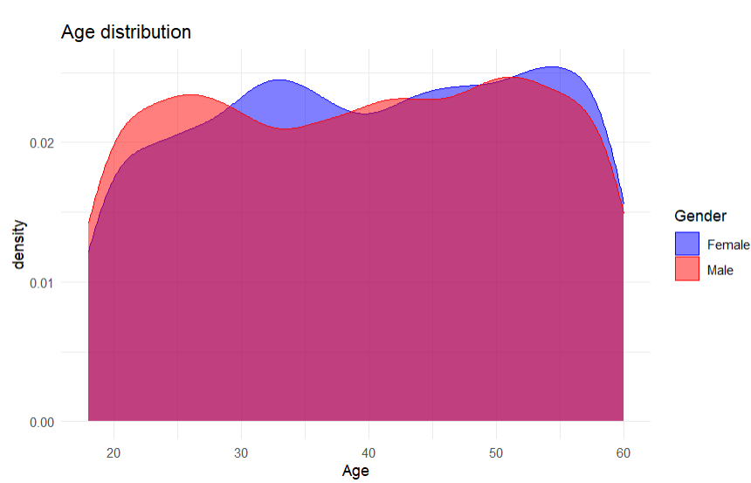
Data Visualization
Age distribution
Age analysis shows that men are more active until the age of 28, then women dominate.
In addition, there are a large number of people over the age of 60.

Slide 6
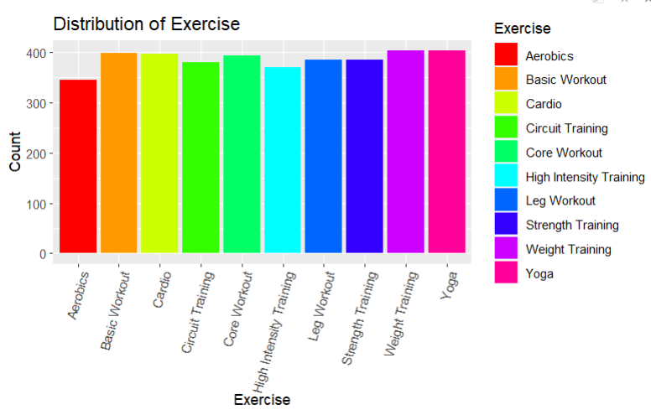
Data Visualization
Exercise distribution
Frequency: The chart reveals the frequency of each exercise type, providing insights into the most common exercises in the dataset.
Diversity: The dataset includes a wide variety of exercises, ranging from "Weight Training" to "Yoga," with varying levels of participation.
This chart serves as a foundational step for exploring the dataset's exercise composition, guiding further data analysis.

Slide 7
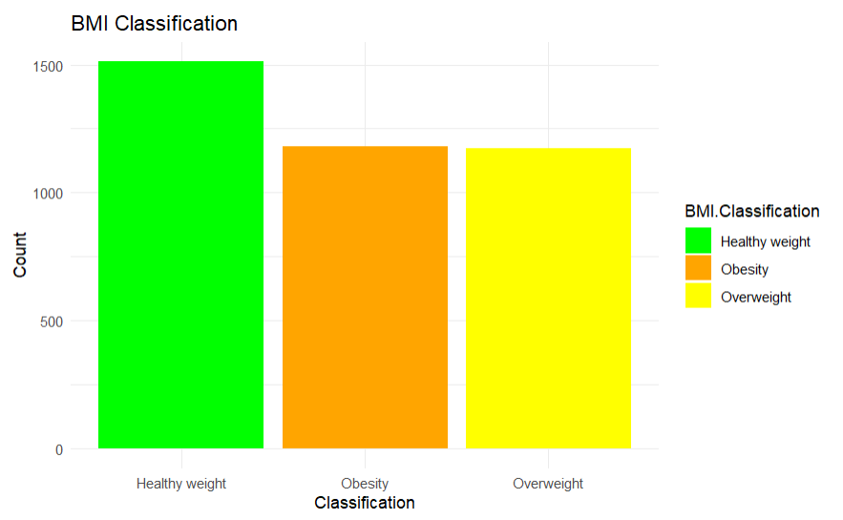
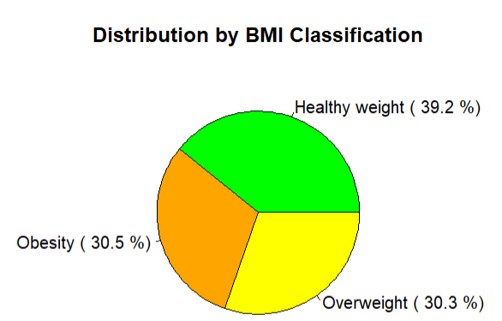
Data Visualization
BMI Classification and Distribution
“Healthy weight” is the most prevalent category, while "Obesity" is also noticeable in the dataset.
The pie chart complements the bar chart, providing a quick and intuitive overview of the dataset's BMI composition.

Slide 8
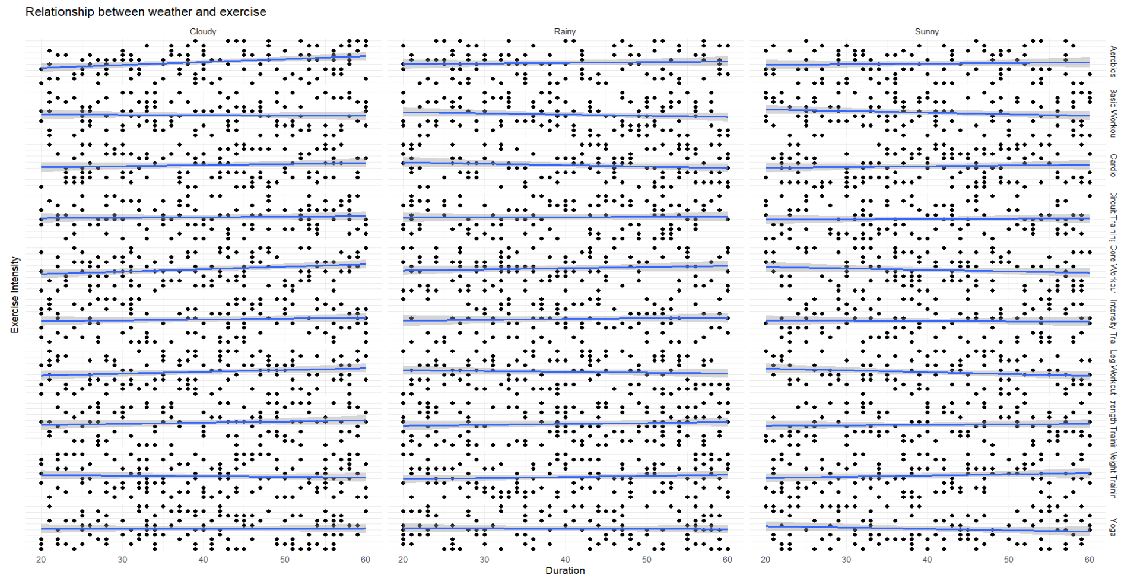
Data Visualization
Weather & Exercise
A grid of scatter plots to explore the relationship between exercise duration and intensity for diverse exercise types and weather conditions.
Line of Best Fit: Improves trend visualization and comprehension through the inclusion of trend lines, simplifying trend analysis.

Slide 9

SMART Questions
How do age, actual weight, and duration collectively influence the relationship between exercise intensity and calorie burn?

Slide 10
Solution

Slide 11
SMART Questions
2. Can we establish a time-based trend in the dataset, such as changes in exercise preferences, calorie expenditure, or weight measurements over time?

Slide 12
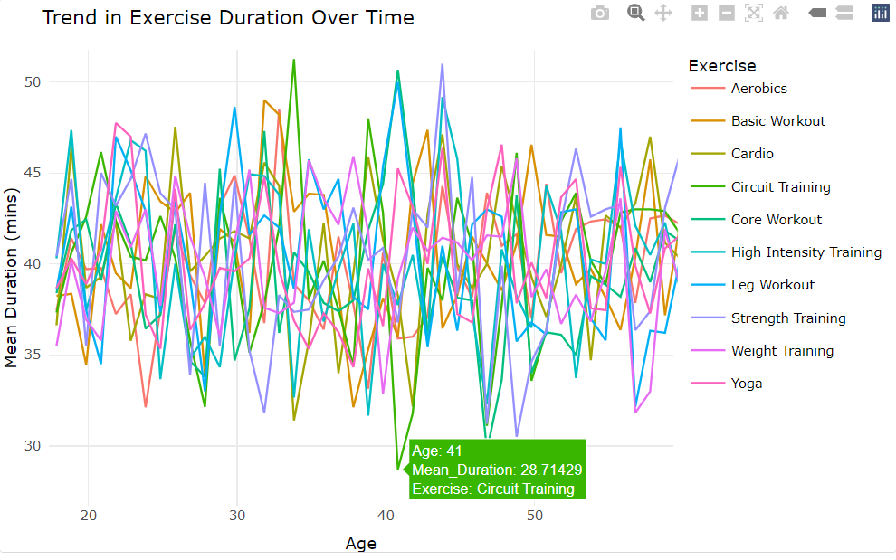
Solution
Age Impacts Exercise Duration: Exercise preferences change with age, influencing the duration of workouts.
Tailored Fitness Programs: Recognizing these trends allows for tailored fitness programs based on age groups.
Promoting Sustainable Habits: Understanding age-related changes promotes healthier, sustainable exercise habits.

Slide 13
SMART Questions
3. Do males and females exhibit different patterns in terms of exercise variety?

Slide 14
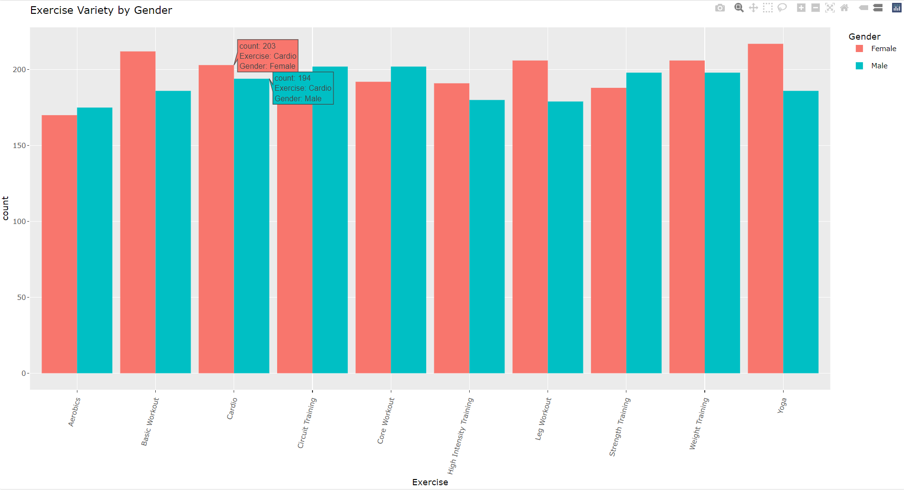
Solution
Gender-Specific Preferences: The plot highlights gender-specific exercise preferences.
Consistent Trends: Similar exercise choices suggest consistency between males and females.
This analysis aids in understanding gender-related differences in exercise variety patterns and identifies any exercise types that are particularly popular among one gender.

Slide 15
SMART Questions
4. Are there exercises more commonly performed indoors or outdoors, depending on the weather?

Slide 16
Solution

Slide 17
SMART Questions
5. Can the combination of heart rate and BMI be used to determine the optimal exercise duration for achieving dream weight?

Slide 18
Solution

Slide 19
SMART Questions
6. How closely do individuals' dream weights align with their actual weights?

Slide 20
Solution

Slide 21
THANK YOU

